Slide 1
What is an organism, and what is it for? Neo-Aristotelian, Darwinian and post-Hamilton perspectives
Paul E. Griffiths

Slide 2
Notes:
LiveSlide Site
https://youtu.be/J3npS5avQeY
Introduction to Charles Perkins Centre

Slide 3
Theory and Methods in Bioscience Group
Current Projects:
A philosophy of medicine for the 21st century (2018–2022)
AUD 2,569,000. Australian Research Council: Australian Laureate Fellowship (Professor Paul Griffiths)
Constructing Objective Biological Criteria of Health (2018–2021)
PIs Paul Griffiths, Pierrick Bourrat; AUD 751,785; John Templeton Foundation.
Norms and Natures: How ideas about the genetic basis and the ethical status of behaviors influence one another (2017–2020)
PIs Paul Griffiths, Ilan Dar Nimrod, Kate Lynch; AUD 423,000; Genetics and Human Agency Project of John Templeton Foundation.
Past Projects
Conceptual and modeling tools for non-paradigmatic evolutionary processes (2015–2016)
PIs Paul Griffiths, Peter Godfrey-Smith, Paul Rainey; AUD 174,000 Australian Research Council
Causal Foundations of Biological Information (2014–2016)
PI Paul Griffiths; USD 1,115,000; Templeton World Charity Foundation
Notes:
Theory and Method in Biosciences group applies the philosophy of science to contemporary biological and biomedical research. It aims to add value by removing conceptual and methodological roadblocks to the advancement of science and by using high level biological theory, particularly an evolutionary perspective, to promote a more integrative approach to research questions.

Slide 4
What is an organism, and what is it for?
“Living chunks of matter do not come, just as such, with instructions about what are allowable conditions of operation and what is to count as allowable input. Similarly, they do not come with instructions telling [what is] damage, breakdowns or weardowns. Nor do they come with instructions about which processes…are to count as occurring within and which are irrelevant or accidental to the system.”
Ruth G. Millikan 2002, 121
Notes:
Back to our topic.
Millikan, Ruth Garrett. “Biofunctions: Two Paradigms.” In Functions: New Readings in the Philosophy of Psychology and Biology, edited by Robert Cummins, André Ariew, and Mark Perlman, 113–43. Oxford: Oxford University Press, 2002.

Slide 5
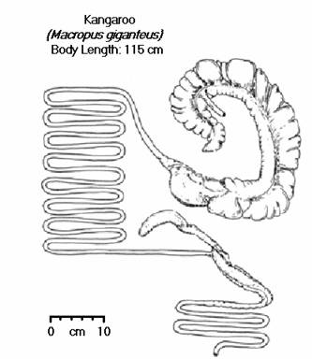
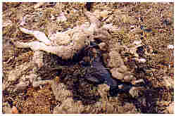
What is an organism, and what is it for?
Millikan’s question is how we distinguishes biological functioning from other causal processes e.g. the kangaroo’s digestive system versus its ‘combustion system’
She argues that biology needs principles to:
identify boundary conditions for the operation of a system
distinguish variation from pathology
delimit the boundaries of a single system

Slide 6
What it is, and what is it for, is not obvious
Notes:
The answers to Millikan’s questions seem obvious for systems we have been introduced to at university, because the problems have all been solved by earlier scientists. But they are not obvious at the time. Leeuwenhoek’s observation of animalcules in human semen were interpreted as pre-formed homunculi, as mechanisms to thrash the semen and keep it fresh, and as parasitic worms – the most popular interpretation. It took over a century to determine the truth. Even today, there have been decades of scientific controversy over whether different sperm morphologies are merely pathological or represent functional specialisation (e.g. ‘killer sperm’).
Leeuwenhoek, Anthoni van. “Observationes D. Anthonii Lewenhoeck, De Natis E Semine Genitali Animalculis.” Philosophical Transactions of the Royal Society 12 (1678): 1040–46.
Moore, H. D. M., M. Martin, and T. R. Birkhead. “No Evidence for Killer Sperm or Other Selective Interactions between Human Spermatozoa in Ejaculates of Different Males in Vitro.” Proceedings of the Royal Society: Biological Sciences 266, no. 1436 (1999): 2343–50.

Slide 7
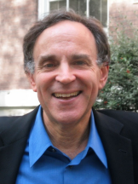
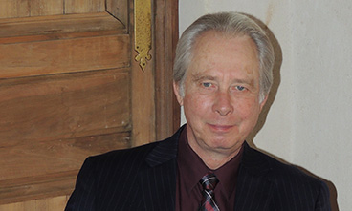
How does this affect philosophy of medicine?
Normative
Natural
Notes:
Because most ‘naturalist’ views of disease use the idea of biological normality (normal function, but also normal structure) as the objective component of their account
Normativist or constructivist views argue that diseases (or injuries or disabilities) are phenotypes that are highly disvalued by a society. This idea finds support from a famous work in the history of medicine, Michel Foucauld’s The Birth of the Clinic (Vintage Books 1975 [1963]) and was popularized in the ‘anti-psychiatry’ movement (Szasz, T., 1987. Insanity, New York: Wiley.) It has a close analogue in contemporary disability studies, where many authors deny that there is an objective basis on which to identify a phenotype as a disability. This is the ‘mere difference’ view of disability and is contrasted to the ‘bad difference’ view of disability. For a good defense of normativism, see Glackin, S. N. “Tolerance and Illness: The Politics of Medical and Psychiatric Classification.” Journal of Medicine and Philosophy 35, no. 4 (August 1, 2010): 449–65. doi:10.1093/jmp/jhq035. Shane is bottom left above ☺
Naturalist, or objectivist views argue that there is an objective, biological difference between function and dysfunction, and that diseases are simply dysfunctional phenotypes (the most famous advocate is Christopher Boorse – far right above).
An obvious compromise is a ‘harmful dysfunction’ theory. This says that diseases are phenotypes which fail to perform their biological function and which are highly disvalued by society. (See Wakefield, J.C., 1992. “The Concept of Mental Disorder,” American Psychologist, 47: 373–388. and see also Neander, Karen. “Mental Illness, Concept Of.” In Encyclopedia of Philosophy, edited by E Craig. London: Routledge, 1998. Retrieved February 16, 2014, from http://www.rep.routledge.com/article/V021.) These are the guys in the centre above.
The consensus view today seems to be normativism but with a substantial minority supporting ‘harmful dysfunction’. For an excellent overview, see: Murphy, Dominic, "Concepts of Disease and Health", The Stanford Encyclopedia of Philosophy (Spring 2015 Edition), Edward N. Zalta (ed.), URL = <http://plato.stanford.edu/archives/spr2015/entries/health-disease/>.

Slide 8
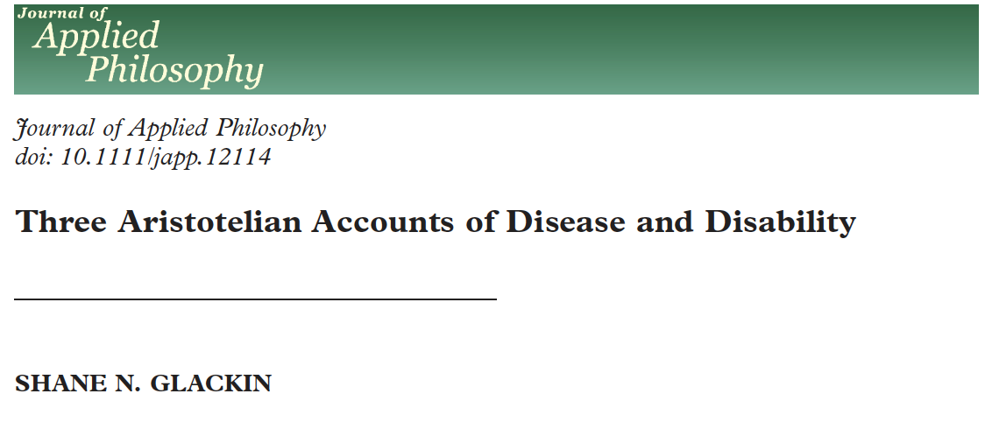
Neo-Aristotelianism
Surprisingly, a popular response to these issues in philosophy of medicine is to revive Aristotelian metaphysics
Megone “the essential properties that make a member of a natural kind the kind of thing that it is are those potentialities that a good member of the kind realizes.” (1998 p. 195, see also 2000, 2007)
The problem with this is simply that Aristotelian essences do not exist
Notes:
Megone, Christopher. “Aristotle’s Function Argument and the Concept of Mental Illness.” Philosophy, Psychiatry, & Psychology 5, no. 3 (1998): 187–201.
Megone, Christopher. “Mental Illness, Human Function, and Values.” Philosophy, Psychiatry, & Psychology 7, no. 1 (2000): 45–65.
Megone, Chris. “Mental Illness, Metaphysics, Facts and Values.” Philosophical Papers 36, no. 3 (2007): 399–426. https://doi.org/10.1080/05568640709485207.
Glackin, Shane N. “Three Aristotelian Accounts of Disease and Disability.” Journal of Applied Philosophy, April 1, 2015, n/a-n/a. https://doi.org/10.1111/japp.12114.

Slide 9
What is an organism and what is it for? #2
There is a naturalistic alternative to neo-Aristotelianism- an account of both what an organism is and of the telos (finalité) of biological organisation
Organisms are self-reproducing systems
Functions (or parts and processes) as contributions to self-reproduction of an overall system
This approach focuses on processes that are autocatalytic or involve some kind of metabolic closure
The approach is part of a larger program to characterize life (Letelier et al 2011)
Notes:
The Krebs cycle is often mentioned as an example of the characteristic ability of biological reactions to feed off their own reaction products, in this case the four-carbon oxaloacetate.
McLaughlin, Peter. What Functions Explain: Functional Explanation and Self-Reproducing Systems. Cambridge: Cambridge University Press, 2001.
Schlosser, G. “Self Re-Production and Functionality: A Systems-Theoretical Approach to Teleological Explanation.” Synthese 116 (1998): 303–54.
Letelier, Juan-Carlos, María Luz Cárdenas, and Athel Cornish-Bowden. “From L’Homme Machine to Metabolic Closure: Steps towards Understanding Life.” Journal of Theoretical Biology 286 (2011): 100–113. https://doi.org/10.1016/j.jtbi.2011.06.033.

Slide 10
What is an organism and what is it for? #2
Theories of Biological Organisation (e.g. Mossio and Moreno 2015) give formal characterizations of what is required for a system to be self-reproducing
They represent the most sustained and rigorous attempt to date to formalize the old idea of ‘circular causality’ – “biological organisation determines itself in the sense that the effects of its activity contribute to determine its own conditions of existence.” (Mossio & Bich 2017)
The account is developed to the point where it resists trivialization through applying to phenomena like flames and hurricanes as well as intended targets like cells and proto-cells.
Notes:
I picture the Chemotron as a good example of the earlier work that inspires the organisational approach:
Moreno, Alvaro, and Matteo Mossio. Biological Autonomy. A Philosophical and Theoretical Enquiry. Springer, 2015.
Montévil, Maël, and Matteo Mossio. “Biological Organisation as Closure of Constraints.” Journal of Theoretical Biology 372 (2015): 179–91. https://doi.org/10.1016/j.jtbi.2015.02.029.
Saborido, Cristian, Matteo Mossio, and Alvaro Moreno. “Biological Organization and Cross-Generation Functions.” The British Journal for the Philosophy of Science 62, no. 3 (2011): 583–606. https://doi.org/10.1093/bjps/axq034.
Mossio, Matteo, Cristian Saborido, and Alvaro Moreno. “An Organizational Account of Biological Functions.” British Journal for the Philosophy of Science 60, no. 4 (2009): 813–41.
Mossio, Matteo, and Leonardo Bich. “What Makes Biological Organisation Teleological?” Synthese 194, no. 4 (2017): 1089–1114. https://doi.org/10.1007/s11229-014-0594-z.

Slide 11
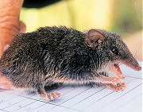
What is an organism and what is it for? #3
The idea that the telos of an organism is the perpetuation of a form, or that organisms are ‘self-maintaining organisations’, is empirically inadequate – examination of actual organisms reveals that they are not organized towards this goal (finalité)
Organisms contain many mechanisms whose goal to degrade and destroy the organism
e.g. the Brown Antechinus (Antechinus Stuartii) shuts down its immune system for a short, ‘big bang’ mating season at the end of which all males die
The biology of ageing and of reproduction are full of mechanisms which trade off organismic integrity for greater representation in the future population
Notes:
Griffiths, Paul E. “In What Sense Does ‘Nothing in Biology Make Sense except in the Light of Evolution’?” Acta Biotheoretica 57, no. 1–2 (2009): 11–32.
Diamond, Jared. “Big-Bang Reproduction and Ageing in Male Marsupial Mice.” Nature 298, no. 5870 (1982): 115–16.

Slide 12
Self-reproduction across generations
Organisational theorists reply that organisms are self-maintaining on two timescales – within and across generations (Saborido et al 2011)
This is sensible, but does not respond to the fact that in the examples given what organisms are doing on the shorter, ontogenetic timescale is NOT maintenance
Self-reproduction, when it occurs, is only one of many functions that are performed in the service of the real goal of the organism, which is just reproduction
Notes:
Saborido, Cristian, Matteo Mossio, and Alvaro Moreno. “Biological Organization and Cross-Generation Functions.” The British Journal for the Philosophy of Science 62, no. 3 (2011): 583–606. https://doi.org/10.1093/bjps/axq034.
This response can even be applied to organisms with alternating life-cycles – image from Image from http://worldofschool.org/Life_cycle_of_animals
Organisational theorists can respond that the molecular pathways underlying e.g. self-immolation in Antechinus are part of a trans-generational process closed under constraints, whereas thing like cellular housekeeping functions are part of an intra-generational process closed under constraints. But the same pathways are involved in numerous physiological processes. The relation between any functions they may have in self-maintenance and their functions in self-destruction will be more like a design compromise in a multi-purpose mechanism

Slide 13
When self-reproduction is maladaptive
Nor do organisms aim at self-reproduction on the longer, phylogenetic timescale
It is well-known that in some ecologies, organisms can increase their fitness by increasing their mutation rate
The higher mutation rate cannot be construed as having the goal of cross-generational self-maintenance, since it makes that outcome less likely
The telos of biological organization is not to make more of the same kind. It is to make more of the same lineage.
Notes:
More controversially, it has been suggested that this can occur as a facultative adaptation to stress in bacteria, which would be an actual adaptation for making your offspring less like you.
The basis issue here is just what David Hull would have suggested – species are not natural kinds in the sense of types, they are historical entities – lineages.
Hull, D. L. “On Human Nature.” Proceedings of the Philosophy of Science Association Vol.1 (1986): 3–13.
Hull, D. L. “Are Species Really Individuals?” Systematic Zoology 25 (1976): 174–91.

Slide 14
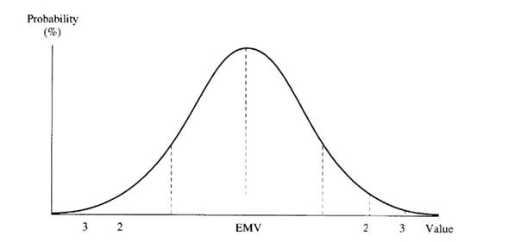
Not self-reproduction, but maximum representation in future populations
The Kakapo is one of many organisms which changes its sex ratio in response to seasonal conditions, producing more females in poor seasons
This is one of many phenomenon in population genetics where fitness depends not only on expected number of offspring, but on the variance (see also the Gillespie effect)
Mechanisms whose goal is to control variance are fundamentally concerned with future populations, not future types
New Zealand Kakapo Strigops habroptilus
Notes:
This argument needs more work to spell it out – Gillespie effect probably a better case to work with than Trivers-Willard effect.
Image from http://www.lecactusheuristique.com/article-trivers-willard-au-secours-des-kakapos-46143800.html
Gillespie, John H. “Natural Selection for Within-Generation Variance in Offspring Number.” Genetics 76, no. 3 (March 1, 1974): 601–6.

Slide 15
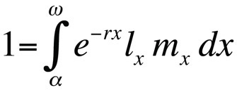
Life history theory as a theory of the organism
The goal (finalité) of an organism is to maximise the probability of surviving to each age class and the number of offspring produced in each age class, integrated across all age classes.
Solutions are constrained by the trade-off between survival and reproduction, and between reproduction in the current age class and reproduction later. Current reproduction trades off against growth, and also against condition. Current growth or condition may trade off with survival to later age classes, etc, etc.
Constrained solutions to this problem generate the diversity of life-histories we see around us
Self-reproduction (maintenance of condition) and the reproduction of form across life-cycles (the existence of stages of ontogeny, whether obligate or facultative) are merely means to this end
Notes:
The nearest thing to a published expression of these views is Griffiths, Paul E., and John Matthewson. “Evolution, Dysfunction and Disease: A Reappraisal.” British Journal for the Philosophy of Science 69, no. 2 (2018): 301-327. https://doi.org/10.1093/bjps/axw021.

Slide 16
Acknowledgments
Theory and Methods in Bioscience Group
Charles Perkins Centre
www.griffithslab.org
2017

